Slide 1
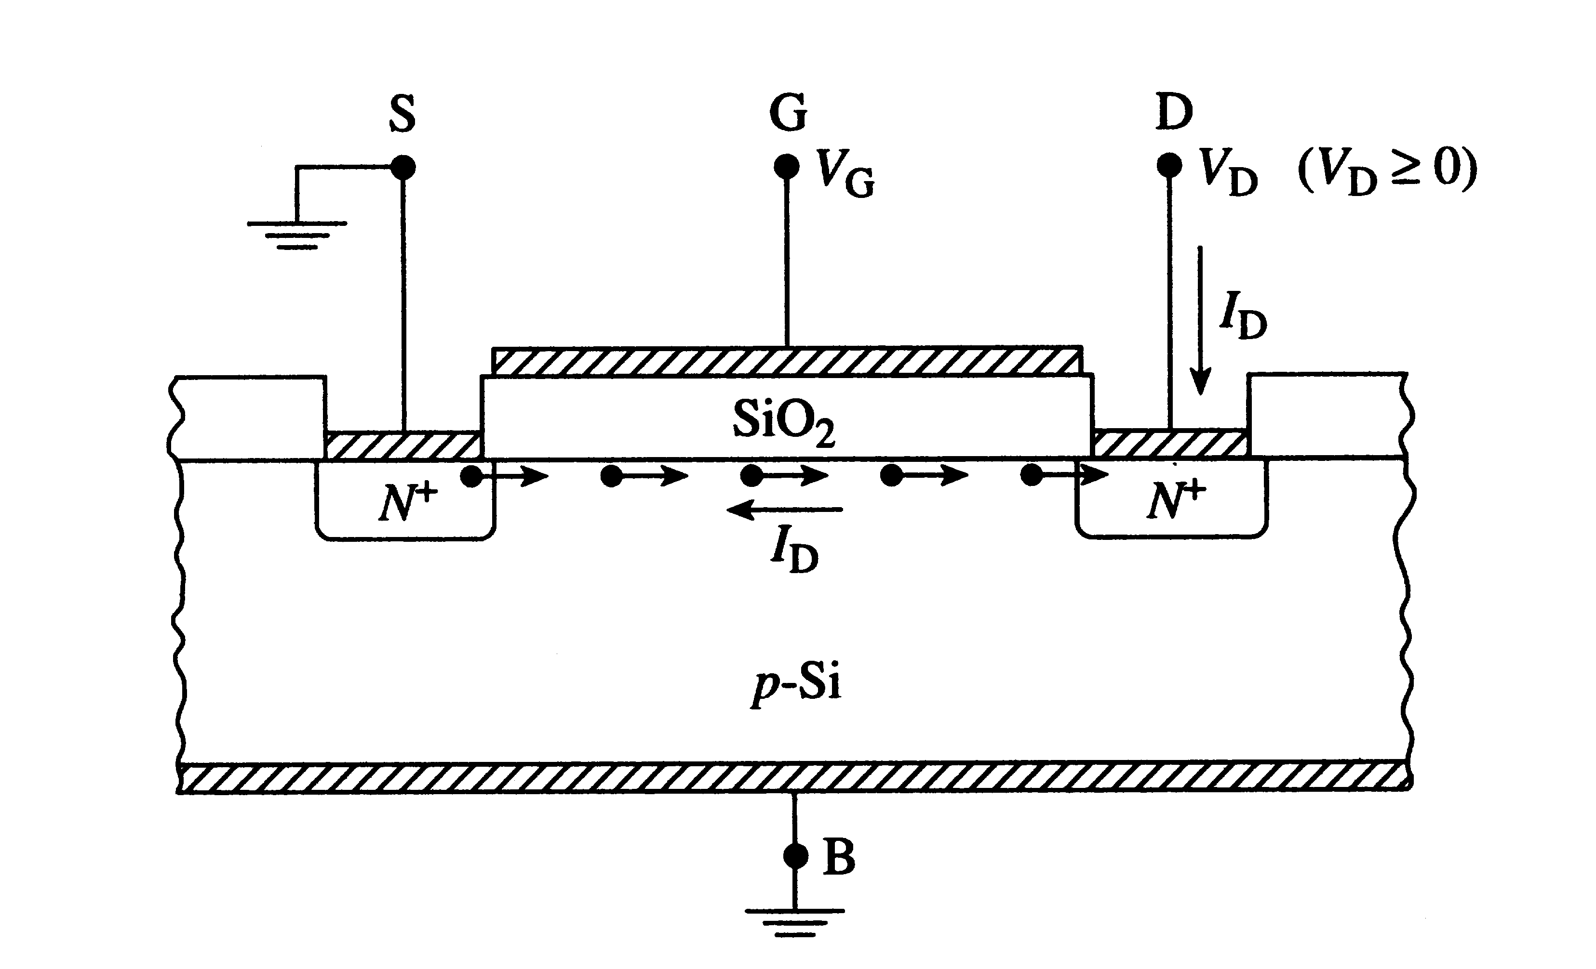
Chapter 17-1. MOSFET
MOSFET based ICs have become dominant technology in the semiconductor industry.
We will study the following in this chapter:
Qualitative theory of operation
Quantitative I_{D}-versus-V_{DS} characteristics
Small-signal equivalent circuits.
N-channel MOSFET
Substrate: p-type Si

Slide 2
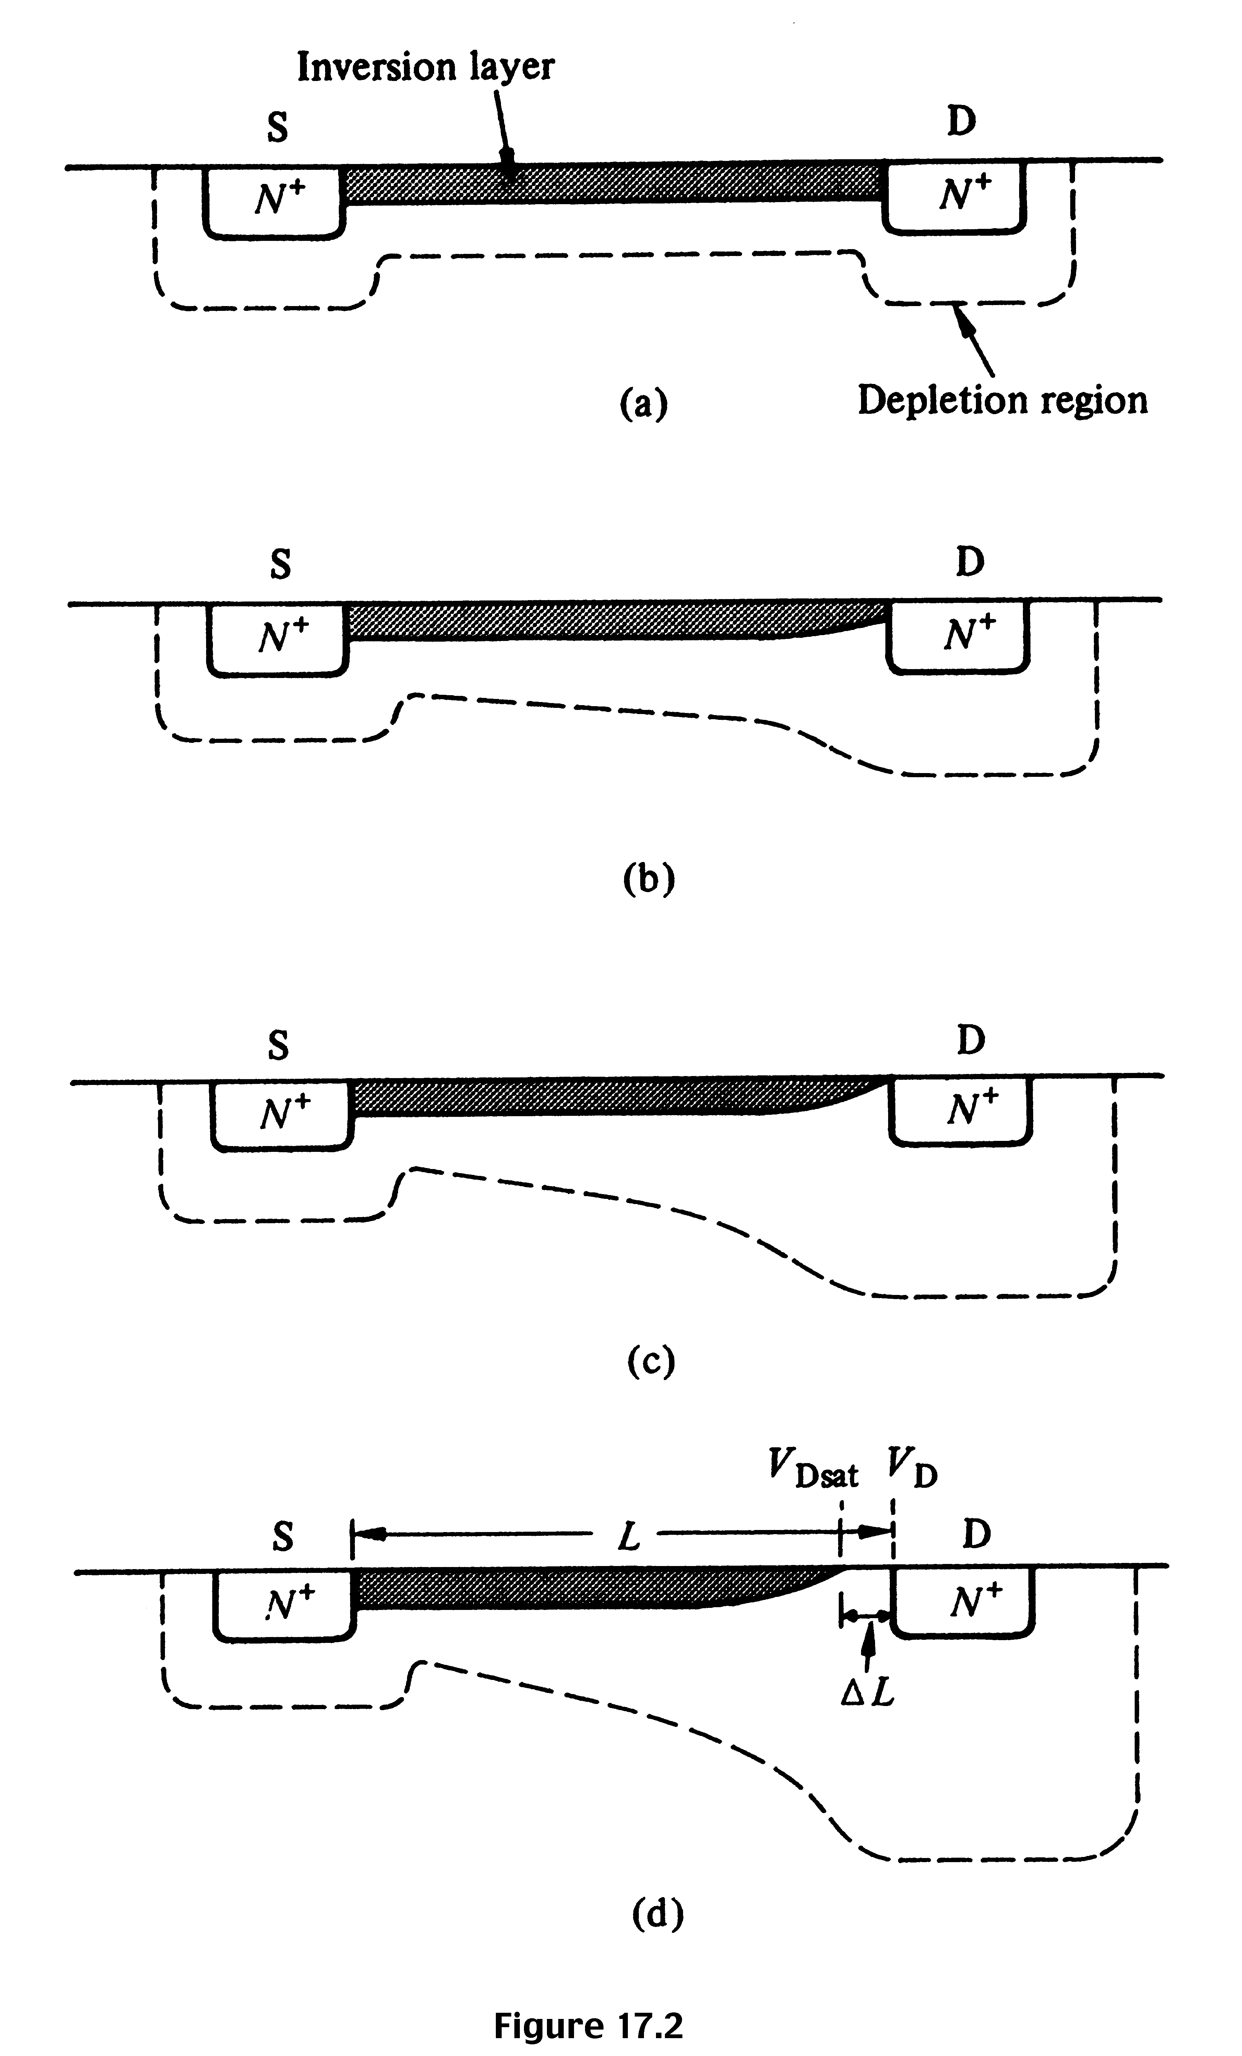
Qualitative discussion: NMOS
N⁺
N⁺
0 < V_{G} < V_{T} ; V_{DS} small or large no channel, no current
p-si
V_{G} > V_{T} ; V_{DS} ≈ 0
I_{D} increases with V_{DS}
V_{G} > V_{T}; V_{DS} small, > 0
I_{D} increases with V_{DS} , but rate of increase decreases.
V_{G} > V_{T}; V_{DS} ≈ pinch-off
I_{D} reaches a saturation value, I_{D,sat} The V_{DS} value is called V_{DS,sat}
V_{G} > V_{T}; V_{DS} > V_{DS,sat}
I_{D} does not increase further, saturation region.

Slide 3
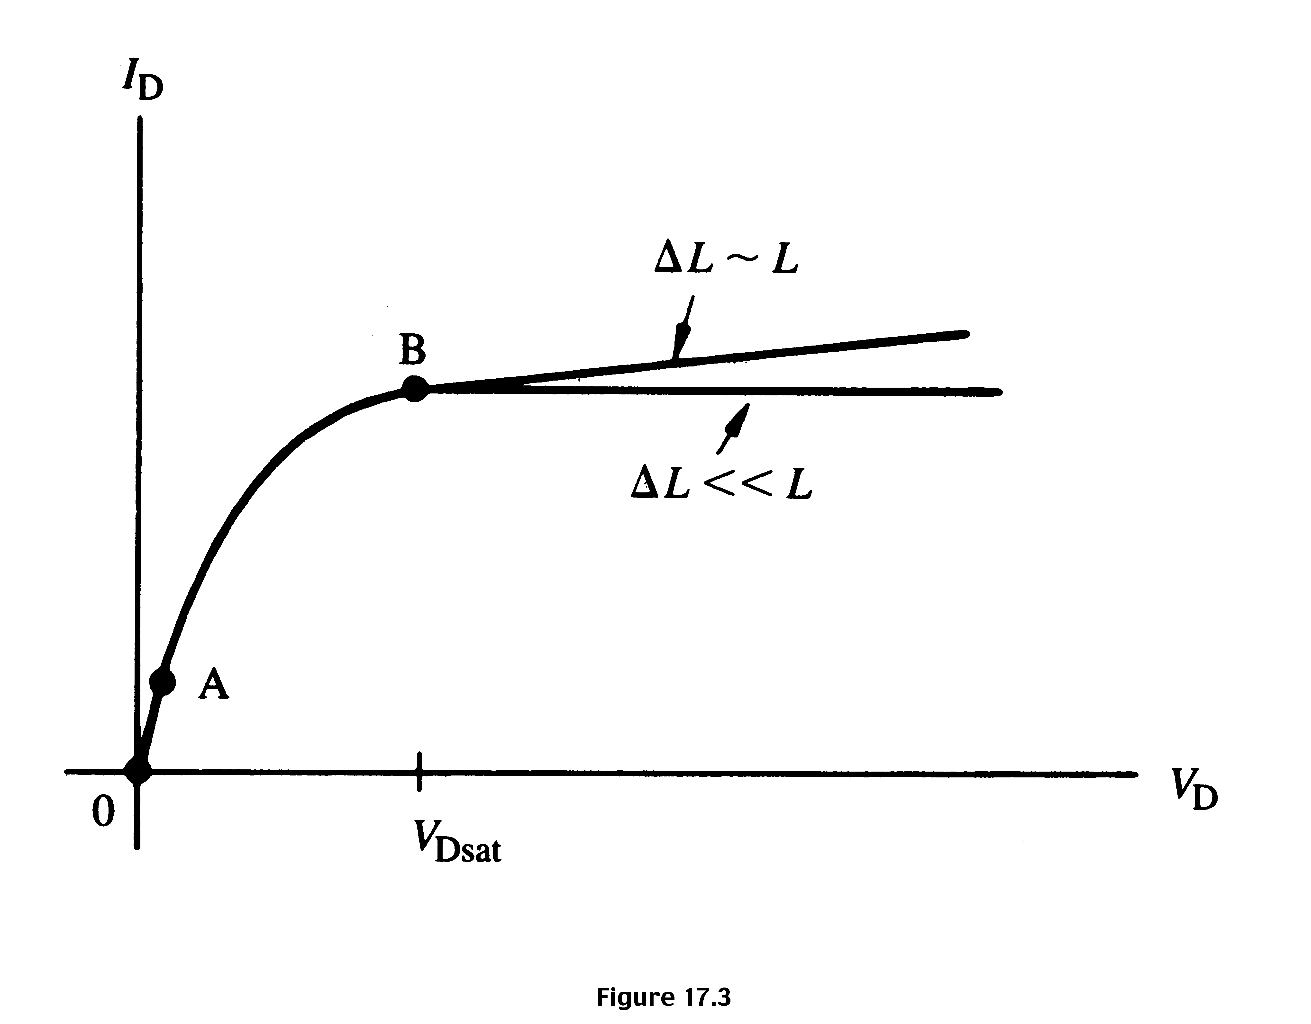
I_{D}-V_{DS} characteristics for NMOS derived from qualitative discussions
Linear
region
Saturation
region

Slide 4
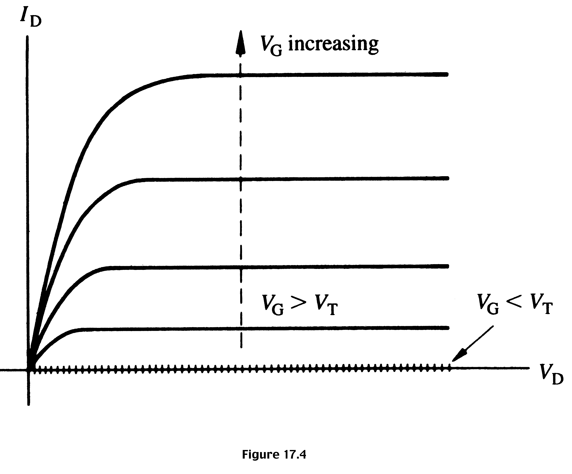
I_{D}-V_{DS} characteristics expected from a long channel
(ΔL << L) MOSFET (n-channel), for various values of V_{G}

Slide 5
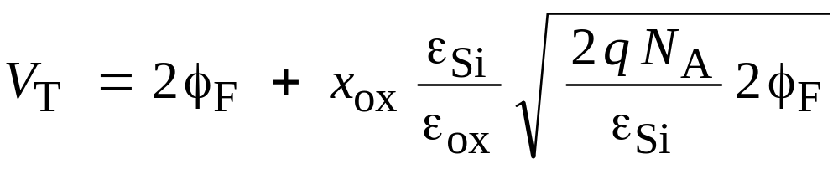
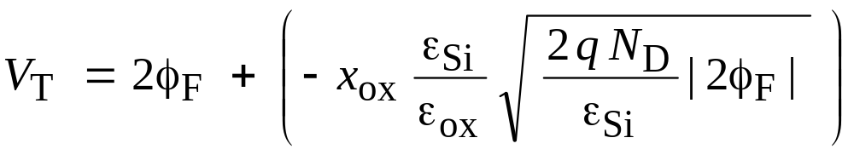
Threshold voltage for NMOS and PMOS
When V_{G} = V_{T}, φ_{s} = 2 φ_{F}; using equation 16.28, we get expression for V_{T}.
Ideal n-channel
(p-silicon) device
both terms positive
Ideal p-channel
(n-silicon) device
both terms negative
ε_{Si} / ε_{ox} = (ε_{r,Si} ε₀) / (ε_{r,ox} ε₀) = 11.9 / 3.9 ≈ 3
ε_{r,Si} = 11.9 = relative dielectric constant of Si
ε₀ = absolute dielectric constant = 8.85 × 10^{–12} A s / (V m)

Slide 6
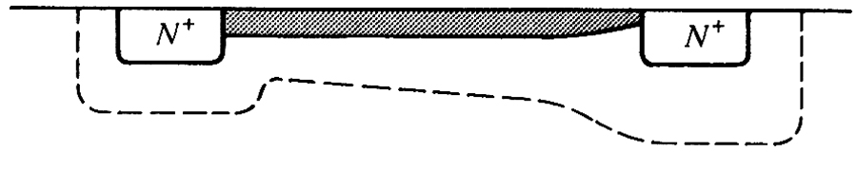


Quantitative I_{D}-V_{DS} relationships
G (V_{G})
S
D (V_{DS})
Q_{N} = inversion layer charge
Let φ be the potential along the channel
For V_{G} < V_{T}, Inversion layer charge is zero.
For V_{G} > V_{T}, Q_{n}(y) = − Q_{G} = − C_{ox} (V_{G} − φ − V_{T})
In general, J_{n}= q μ_{n} n E when the diffusion current is neglected.
Here, current I_{D} is the same everywhere, but J_{n} (current density)
can vary from position to position.

Slide 7
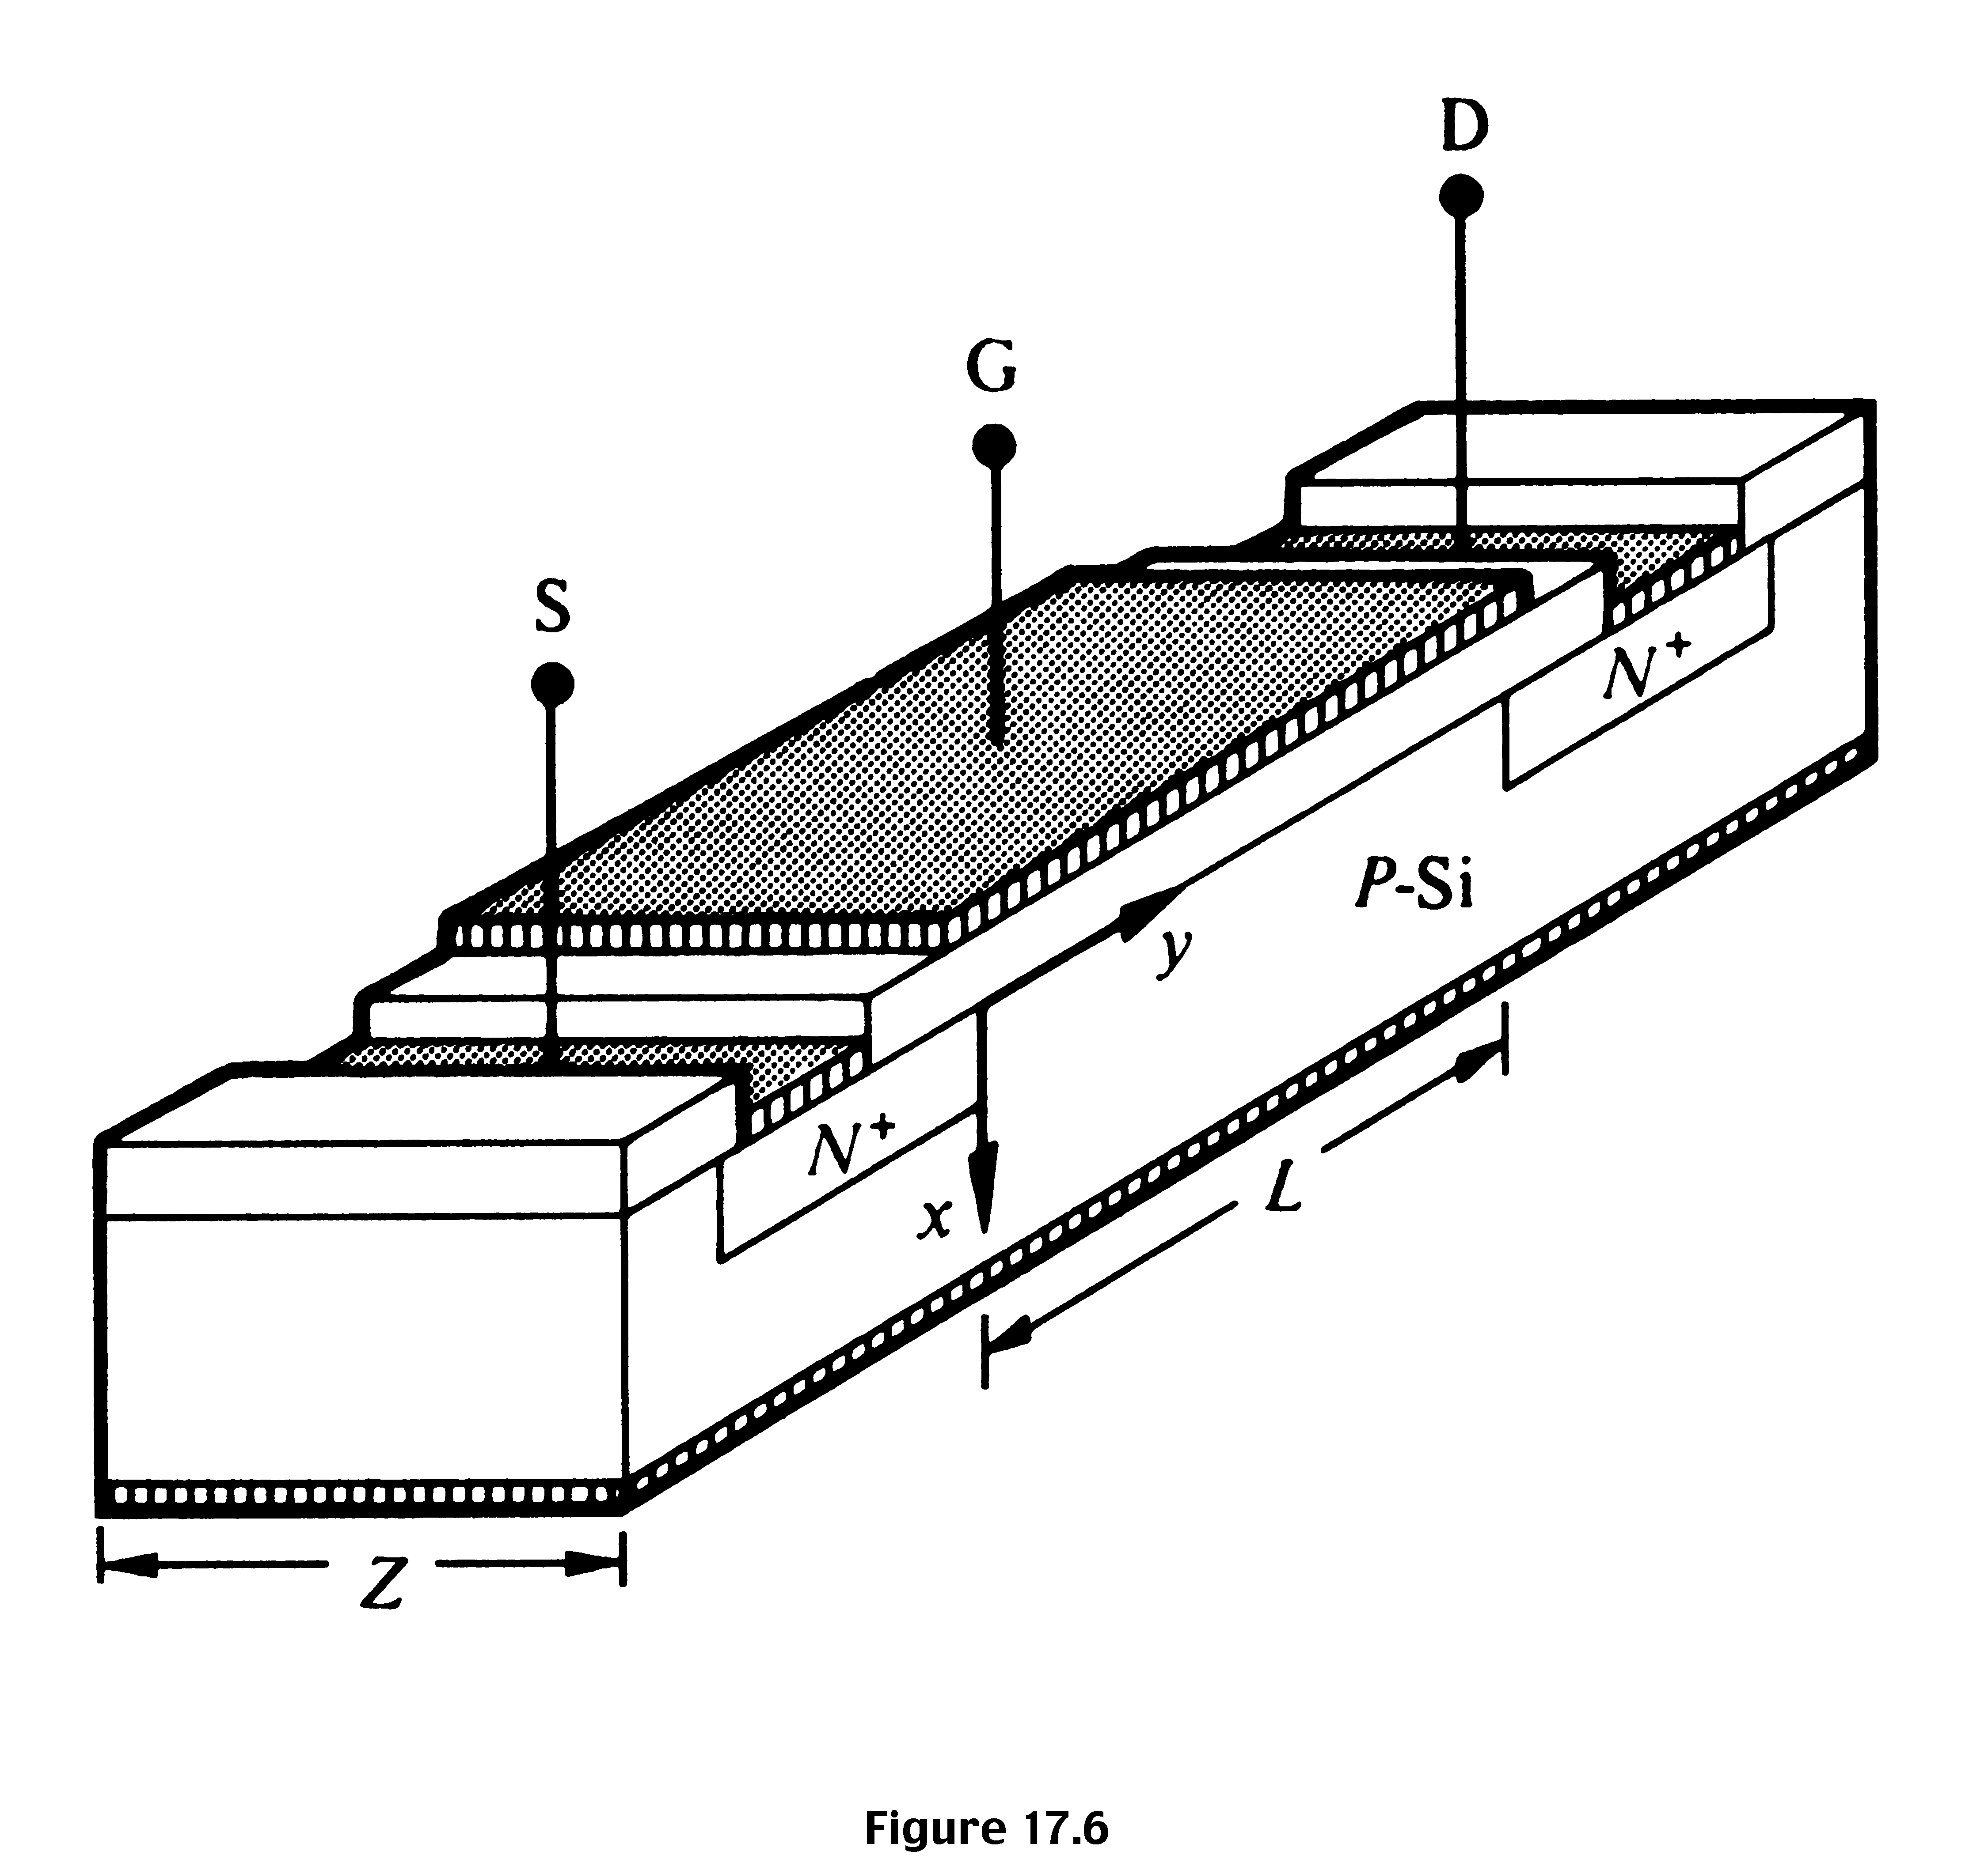
Device structure, dimension, and coordinate orientations assumed in the quantitative analysis

Slide 8
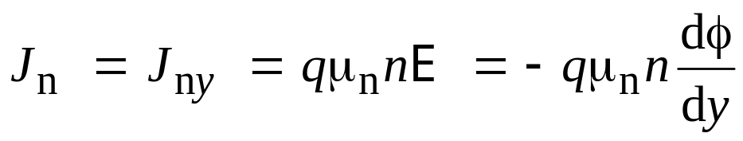
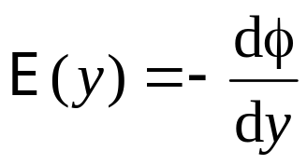
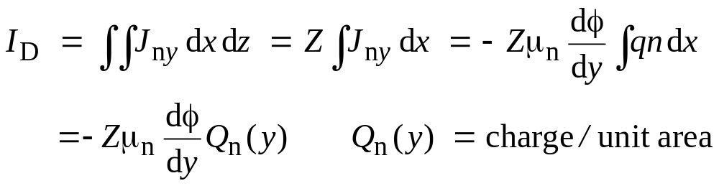
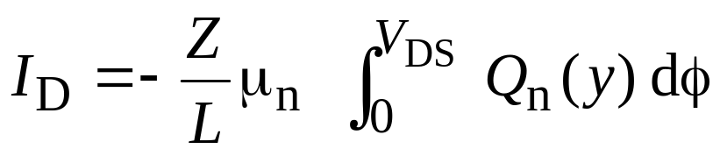
Quantitative I_{D}-V_{DS} relationships (Shockley model)
since
To find current, we have to multiply the above with area, but J_{ny},
n, etc. are functions of x and z. Hence,
Integrating the above equation, and noting that I_{D} is constant, we get
Since we know expression for Q_{n}(y) in
terms of φ, we can integrate this to get I_{D}

Slide 9
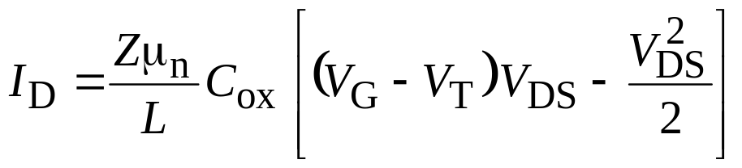


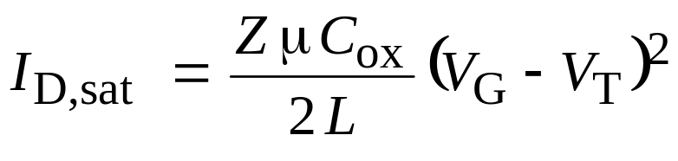


Quantitative I_{D}-V_{DS} Relationships (cont.)
;
I_{D} will increase as V_{DS} is increased, but when V_{G} – V_{DS} = V_{T}, pinch-off of channel occurs, and current saturates when V_{DS} is increased further. This value of V_{DS} is called V_{DS,sat}. i.e., V_{DS,sat} = V_{G} – V_{T} and the current when V_{DS}= V_{DS,sat} is called I_{DS,sat}.
;
Here, C_{ox} is the oxide capacitance per unit area, C_{ox} = ε_{ox} / x_{ox}

Slide 10
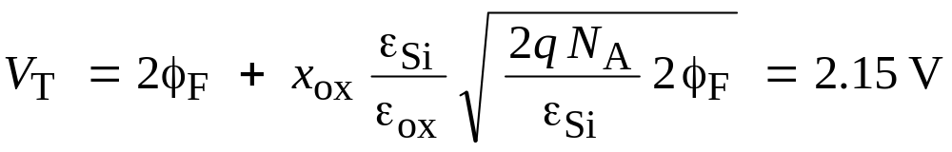
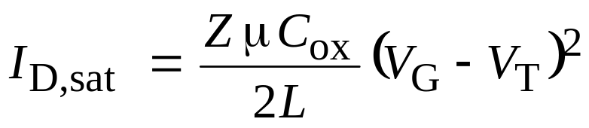

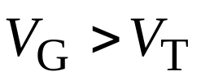
Example 1
Plot the I_{D} vs. V_{DS} characteristics for an NMOS with the following
parameters:
Substrate doping: 10¹⁶ cm^{–3}. Oxide thickness = 100 nm
Gate width = 15 μm; Gate length = 1 μm. Assume μ_{n} = 500 cm²/(Vs)
Find C_{ox}:
C_{ox} = ε_{ox} / x_{ox}= 33.3 nF/cm²
;
V_{DS,sat} = V_{G} – V_{T}
Find I_{D,sat} for different values of V_{G} and plot the graph

Slide 11
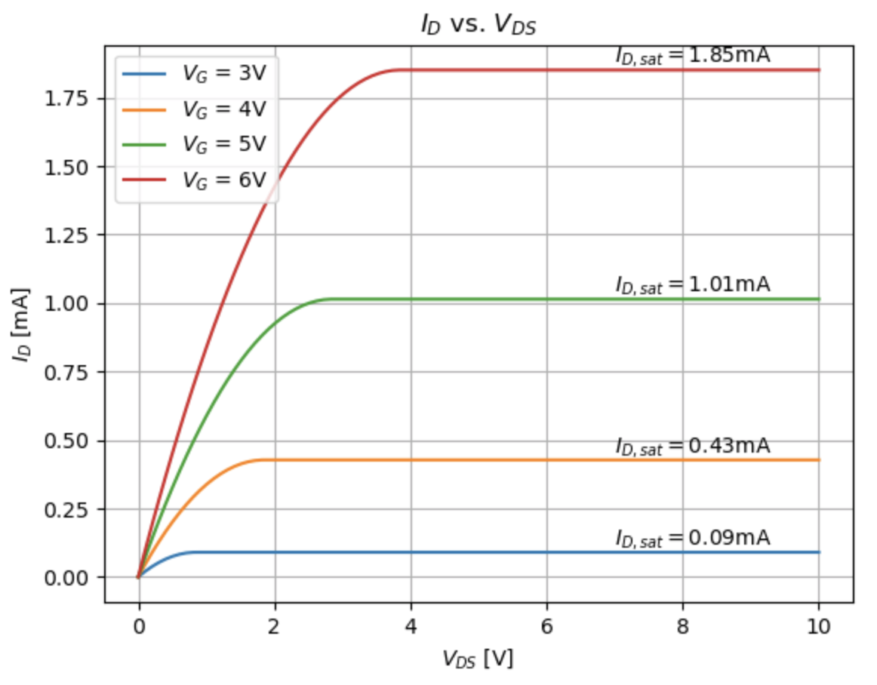
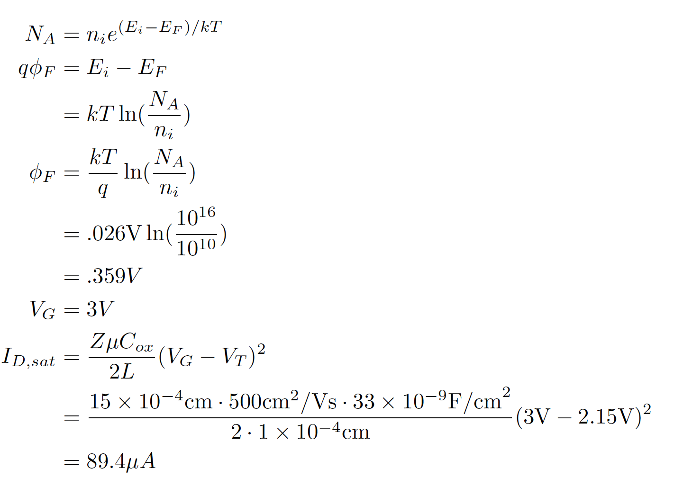
Solution

